Slide 1

Advertising Strategies for APPs
Tao Huang, Lorry Zou, Xinrui Liu, Bocong Yu
*Worldwide Mobile App User Behavior Dataset Analysis

Slide 2
Catalog
Introduction
Data
Analysis

Slide 3
Introduction
While free apps have far outnumbered the paid ones and earn profits mainly from in-app advertisements, in recent years in-app purchases and paid-download are becoming more popular.
Indeed, Invesp shows that in-app purchases account for 48.2% of mobile app earnings, and paid app downloads account for 37.8%, with an overall of 86%. Therefore, customers’ purchase behaviors in apps are critical for app company’s revenues.
In this presentation, we analyze different customer behaviors and mindsets through the datasets, aiming at providing app developers insights in increasing customer purchases and thus profits.
Source: https://www.spaceotechnologies.com/how-do-free-apps-make-money/; https://www.preapps.com/blog/free-apps-vs-paid-apps/

Slide 4
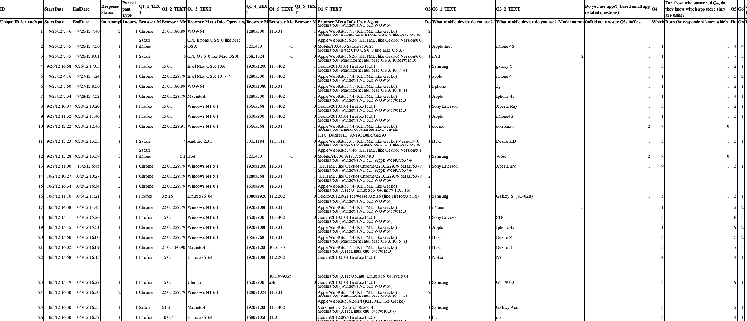
Data
Only complete and valid responses are used in our data analysis. We dropped all the lines which “Response Status” is 2 or 3 and only lines with “Response Status”=1 are used. Then we dropped all answers that are “Others”/“I don't know” of all questions, including q8 q9 q10 q11 q14 and q20

Slide 5
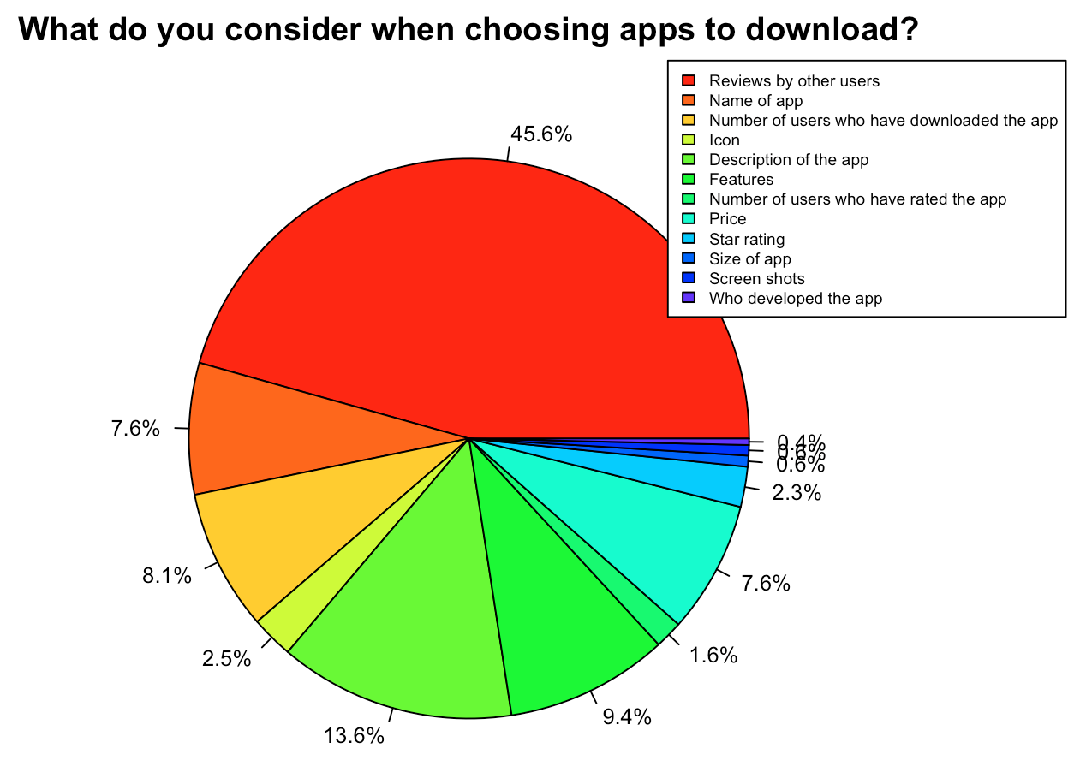
Analysis
Most users value reviews by other users more than any other factors. Therefore, app developers can advertise more by inviting or paying people to try the app and write reviews.
On average, people are less likely to consider the size of app and developers. Therefore, small or less renown companies aren’t at a very disadvantageous status.

Slide 6
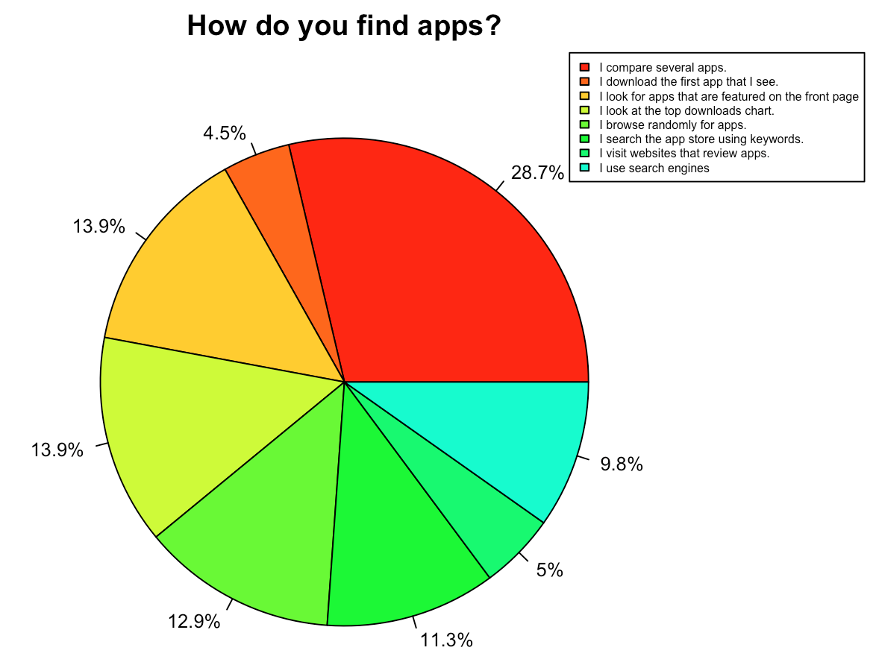
Analysis
Most (66.5%) customers find apps after comparison or certain exposure of the apps, while only 12.9% customers randomly browse for apps. Therefore, advertising is necessary.
Investing on websites that review apps aren’t much effective as many people may imagine. There are only 5% customers really find apps from these websites.

Slide 7
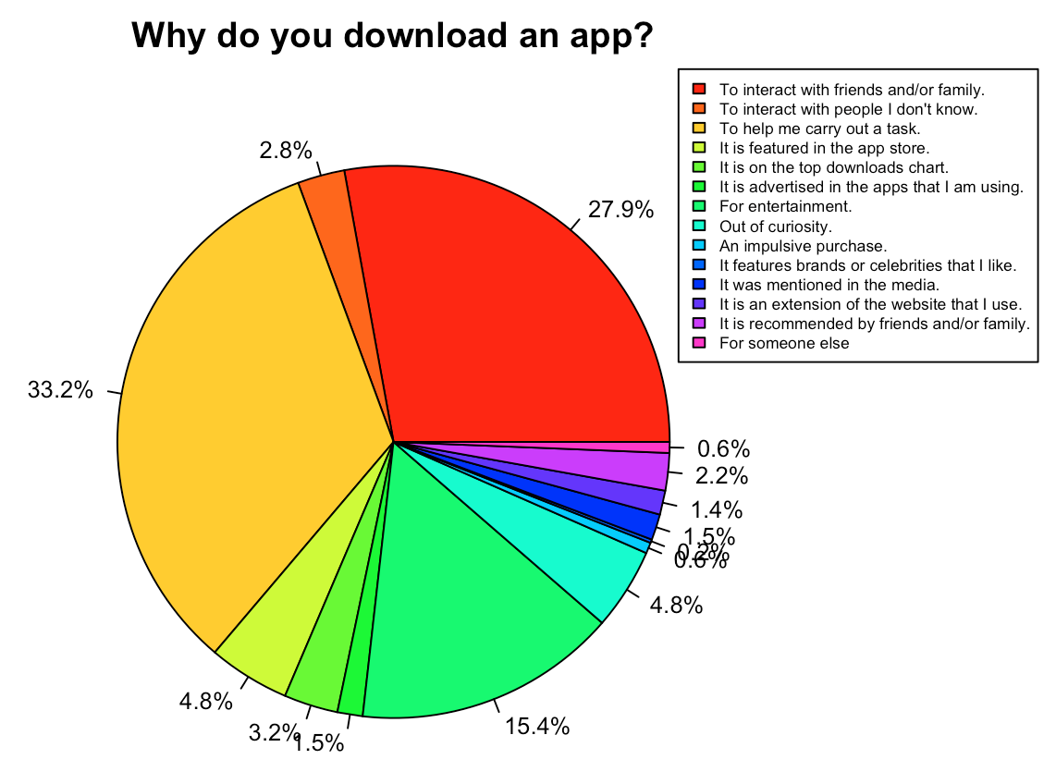
Analysis
The top reason (33.2%) that customers download an app is for functional reason, namely helping them carry out a task. Therefore, apps that serve a clear function is critical in attracting customers around the world.
People also tend to download apps to interact with family and friends, which is evidenced by the popularity of snapchat and other social medias.
This dataset may be a big outdated because during recent two to three years tiktok has become very popular, more people download these apps to encounter people they don’t know.

Slide 8
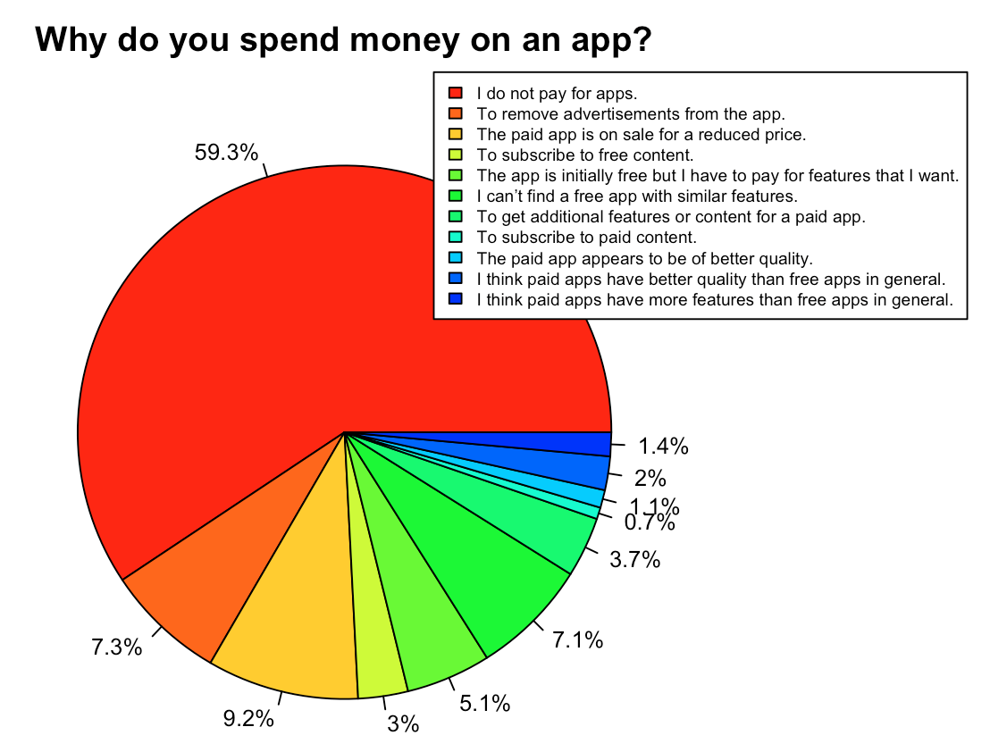
Analysis
For reasons that people pay for app, more than half of the reasons are that they don’t actually spend for apps. This has indicated the spending habits for majority of people is getting apps for free.
However, the top reason for people to spend money on an app is when the app is on sale (9.2%). Therefore, one strategy is to hold some discount activities and advertise them.
Many customers also pay for removing advertisements, which indirectly shows how customers dislike in-app advertisements. Thus, app developers should try to reduce in-app advertisements in order to improve customers’ experiences.

Slide 9
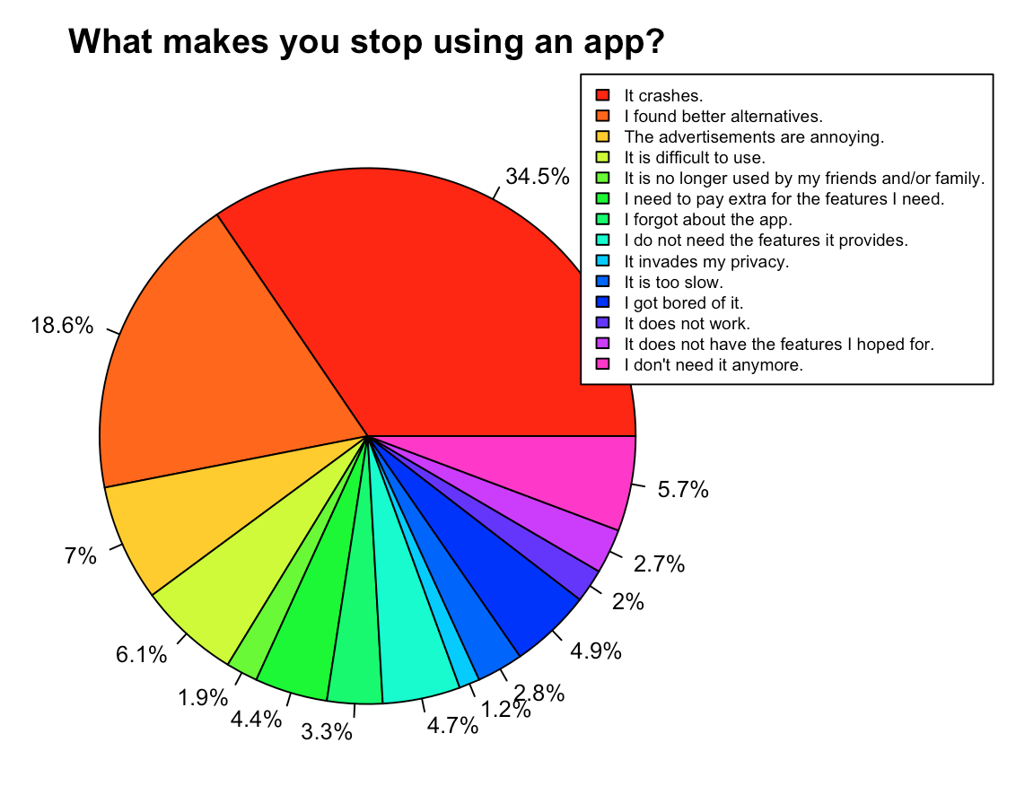
Analysis
For the reasons that people stop using an app, the majority answer is that it crashes.
Therefore, for app developers, it is really crucial for them to make sure the app is working.
The second majority one is that people find a better alternative， which shows it is important for the developers to keep update new features to the app so people are not being attracted by other apps.

Slide 10
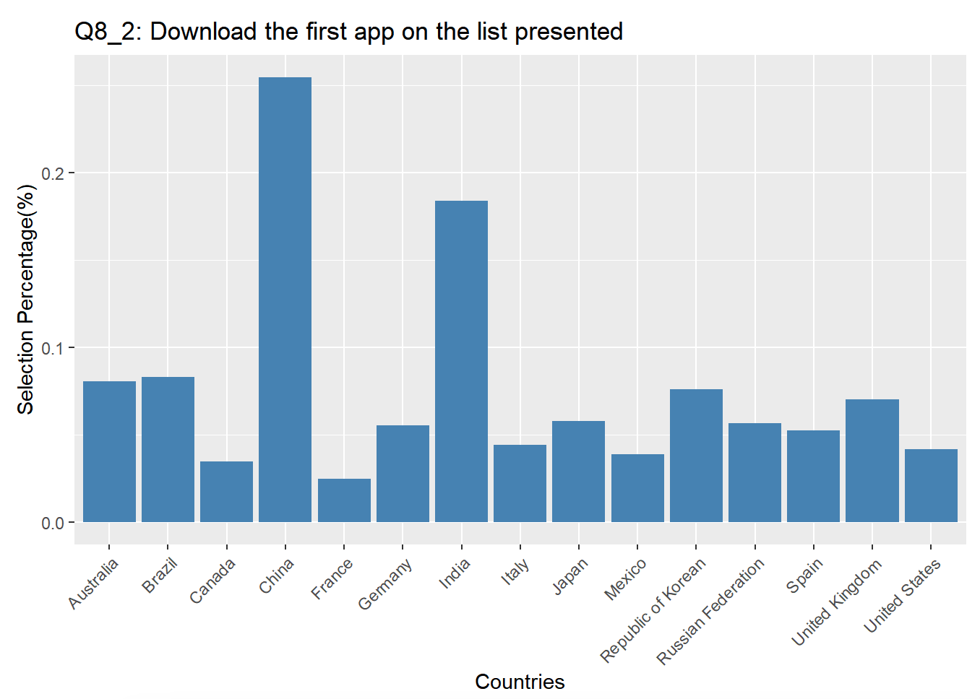
Analysis
Regarding Q 8 “How do you find apps,” the answers are not varying very much.
The difference in culture of each country is not taking much influence when it comes for people to search for the app to download. However, the only graph with a significant answer for this question is Q8_2. Far more people tend to download the first app presented in China and India than in other countries. This can be caused by the tremendous population of these two countries that a lot more people are just taking whatever app is presented first.

Slide 11
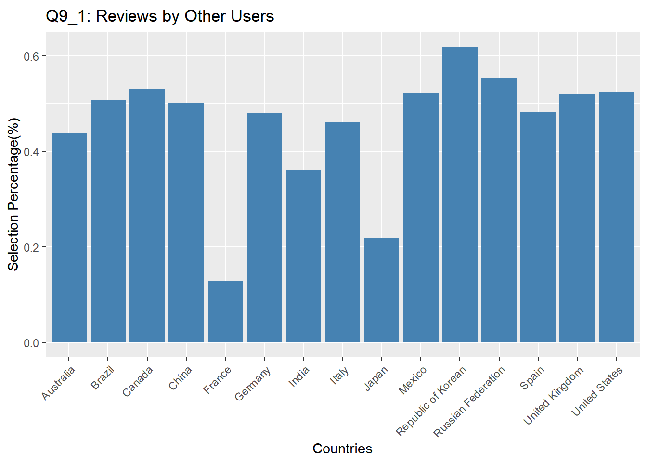
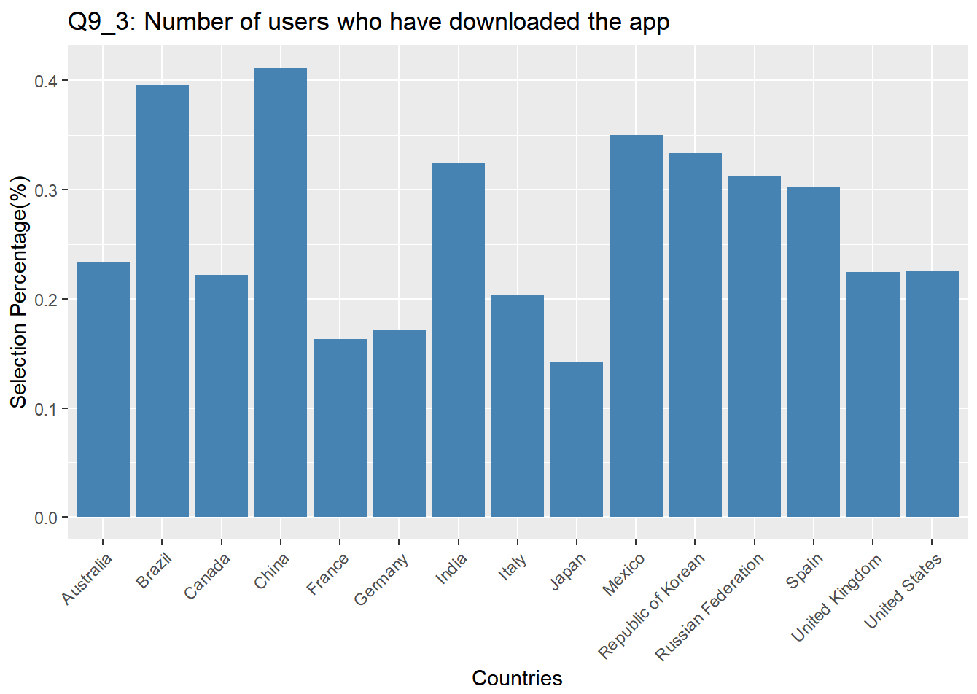
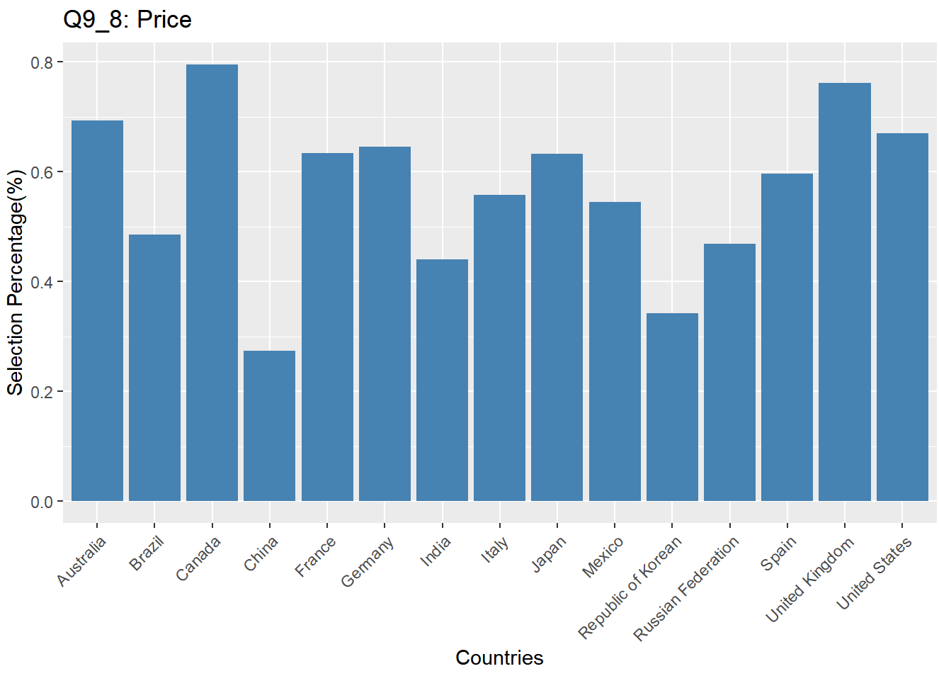
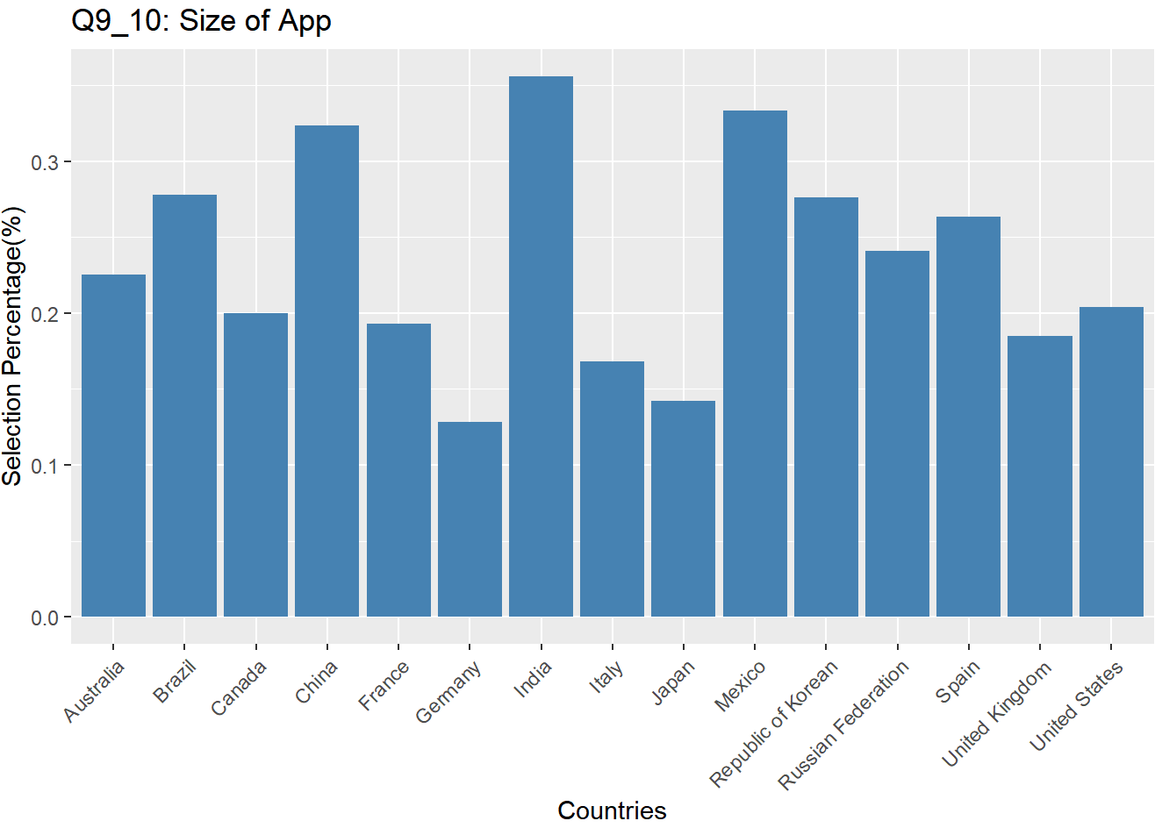
Analysis
Regarding Q 9 “What do you consider when choosing apps to download,” we investigate how customers from different countries obtain various preferences.
Here are the relationships between the ten choices and different countries’ customers. For example, Indian customers take the size of apps into consideration a lot. If an app wants to expand market in China, rather than intuitively consider price as a critical factor, number of people who rated the app, size of app, name of app, and the number of users who have downloaded the app are more influential. Therefore, effective advertising should emphasize more on these aspects, such as highlighting that one in ten people use this app.

Slide 12
Thank You.

